Slide 1
MICROSOFT INTERNAL: Azure Core Enablement Reminder
This Data & AI Core Enablement is a middle step on an enablement path.
Please ensure that you have had an Apps and Infra Core Enablement to set up key infrastructure (AAD, VNET Topology, etc)
You will likely not be successful unless you do Azure Core Enablement prior to this Data & AI Session
https://aka.ms/AzCoreEnablement

Slide 2
Team Data Science Process

Slide 3
Challenges of Machine Learning Projects
Misunderstanding the project’s goal
Not defining a goal/success criteria
Model fails to generalize to new data
The model is considered “set in stone” and never re-evaluated / re-trained.
Business users lack buy-in
Reinventing the wheel
Limited reuse of modeling efforts
Notes:
Overview of the different challenges a customer faces.
Try to relate the challenges here to the challenges discovered by your team for the customer

Slide 4

Data Science Lifecycle
Notes:
Overview of the Data Science Lifecycle as seen by TDSP
Review each section and emphasize the iterative nature of the process where one step informs the next and you could be sent back a step or two as you learn more through the process.

Slide 5
Business Understanding

Slide 6


Business Understanding Goals
Define Objectives
Type of problem
Quantifiable Criteria
Specify Roles
Success Metrics
Identify Data Sources
Which data is relevant?
Timely access to that data
Notes:
Two main goals of Business Understanding stage is to define your objective and identify potential data sources with useful information relative to your goal.
A Charter Document contains the high-level plan, architecture, goals, and people/roles involved with the ml project.
https://github.com/Azure/Azure-TDSP-ProjectTemplate/blob/master/Docs/Project/Charter.md
Data Sources consist of a listing raw, processed, and feature datasets that are involved with the project
https://github.com/Azure/Azure-TDSP-ProjectTemplate/blob/master/Docs/Data_Report/Data%20Defintion.md#raw-data-sources
Data Dictionary is a central location for describing each dataset’s attributes such as what each column means or the calculation done to create that column
https://github.com/Azure/Azure-TDSP-ProjectTemplate/tree/master/Docs/Data_Dictionaries

Slide 7

Define Objectives
SMART Goals
Specific
Measurable
Achievable
Relevant
Time-bound
“Predict Next Year’s Sales”
versus
“Estimate month-end sales with a 0.95 confidence bound of each territory for the next 12 months by mid-Q4 so that the Sales Analysts can allocate sales team resources to high and low potential territories”
Notes:
Emphasize that with “SMART” goals, it becomes easier to understand the problem and know whether or not you have solved that problem.

Slide 8
Organizational Structure
Data Science
Department
Marketing
Data Science
Org
Data Scientist
Marketing
Finance
Data Scientist
Finance
Others
Data Scientist
Others
Data Scientist
Centralized
Consulting
Marketing
Marketing
Finance
Data Scientist
Data Scientist
Marketing
Biz Analyst
Data Science
CoE
Finance
Data Scientist
Data Science
VTeam
Finance
Data Scientist
Data Scientist
Others
Others
Others
None
Data Scientist
None
Center of Excellence
Functional
Decentralized
Notes:
1. Centralized. Analysts reside in one central group where they serve a variety of functions and business units and work on diverse projects. Besides providing analytical expertise and support, a centralized unit sets the analytical direction of the entire organization. This structure makes it easier to deploy analysts to projects with strategic priority. Candy giant Mars uses this approach; its centralized Catalyst group has long-term funding and works on strategic initiatives across the company.
2. Center of excellence. Analysts work in units throughout the organization, but their activities are coordinated by a central entity. The center builds a community of analysts, primarily to share knowledge and best practices. It can also double as a project management office, looking at many analytical initiatives, setting priorities and staffing projects. Capital One and Wal-Mart both employ versions of this model.
3. Consulting. Analysts work together in a central group but act as internal consultants who charge business units for their services. The consolidation of analysts enables some enterprise-wide coordination of analytical activities. United Airlines, eBay and trucking firm Schneider National all employ the consulting approach.
4. Functional. Analysts are located in the functions where the most analytical activity takes place, such as marketing or the supply chain. Fidelity uses this approach: most analysts work in the Customer Knowledge group, which reports to marketing. Analysts are also found in large numbers in marketing at GE Money (although they also work for the risk management function and other groups) and at Carnival Cruise Lines.
5. Decentralized. Analysts are scattered across the organization in different functions and business units with little coordination. Companies with few analysts and little management support for analytics are most likely to be decentralized.
http://analytics-magazine.org/executive-decisions-how-to-organize-your-analytical-talent/
https://hbr.org/product/analytics-at-work-smarter-decisions-better-results/12167-HBK-ENG

Slide 9

Specify Roles
Group Manager
Team Lead
Project Lead
Project Individual Contributor
Notes:
Group Manager. Group Manager is the manager of the entire data science unit in an enterprise. A data science unit might have multiple teams, each of which is working on multiple data science projects in distinct business verticals. A Group Manager might delegate their tasks to a surrogate, but the tasks associated with the role do not change.
Team Lead. A team lead is managing a team in the data science unit of an enterprise. A team consists of multiple data scientists. For data science unit with only a small number of data scientists, the Group Manager and the Team Lead might be the same person.
Project Lead. A project lead manages the daily activities of individual data scientists on a specific data science project.
Project Individual Contributor. Data Scientist, Business Analyst, Data Engineer, Architect, etc. A project individual contributor executes a data science project.
https://docs.microsoft.com/en-us/azure/machine-learning/team-data-science-process/roles-tasks
Group Manager Tasks
Create a group account on a code hosting platform (like GitHub, Git, Azure DevOps, or others)
Create a project template repository on the group account, and seed it from the project template repository developed by Microsoft TDSP team. The TDSP project template repository from Microsoft
provides a standardized directory structure including directories for data, code, and documents,
provides a set of standardized document templates to guide an efficient data science process.
Create a utility repository, and seed it from the utility repository developed by Microsoft TDSP team. The TDSP utility repository from Microsoft provides
a set of useful utilities to make the work of a data scientist more efficient, including utilities for interactive data exploration, analysis, and reporting, and for baseline modeling and reporting.
Set up the security control policy of these two repositories on your group account.
For detailed step-by-step instructions, see Group Manager tasks for a data science team.
Team Lead
If Azure DevOps is selected to be the code hosting platform for versioning and collaboration, create a project on the group's Azure DevOps Services. Otherwise, this task can be skipped.
Create the project template repository under the project, and seed it from the group project template repository set up by your group manager or the delegate of the manager.
Create the team utility repository, and add the team-specific utilities to the repository.
(Optional) Create Azure file storage to be used to store data assets that can be useful for the entire team. Other team members can mount this shared cloud file store on their analytics desktops.
(Optional) Mount the Azure file storage to the Data Science Virtual Machine (DSVM) of the team lead and add data assets on it.
Set up the security control by adding team members and configure their privileges.
Project Lead
Create a project repository under the project, and seed it from the project template repository.
(Optional) Create Azure file storage to be used to store data assets of the project.
(Optional) Mount the Azure file storage to the Data Science Virtual Machine (DSVM) of the Project Lead and add project data assets on it.
Set up the security control by adding project members and configure their privileges.
Project Individual Contributor
Clone the project repository set up by the project lead.
(Optional) Mount the shared Azure file storage of the team and project on their Data Science Virtual Machine(DSVM).
Execute the project.

Slide 10


Identify Data Sources
Internal Data Sources
Operations databases
Data warehouses
Web server logs
Spreadsheets
Application telemetry
External Data Sources
Weather
Census
Federal reserve
Academic datasets
Third-party APIs
Notes:
Identifying where the data is coming from may at first appear easy but you should also consider topics like:
Is the goal of the project to be real-time or in batch?
If it’s real-time, do you have historical data based on the raw data or only aggregated processed data.
Do you have backups that can be leveraged for historical data?
What are the ways data is being collected and what biases may be introduced
Are there external data sources that could be brought in (free or purchased)?
Watch out for historical data receiving updates from a third-party source with only current data rather than appropriate timeframe data.

Slide 11

Business Understanding Deliverables Charter Document Data Sources Data Dictionaries
Notes:
Charter document: A standard template is provided in the TDSP project structure definition. The charter document is a living document. You update the template throughout the project as you make new discoveries and as business requirements change. The key is to iterate upon this document, adding more detail, as you progress through the discovery process. Keep the customer and other stakeholders involved in making the changes and clearly communicate the reasons for the changes to them.
Data sources: The Raw data sources section of the Data definitions report that's found in the TDSP project Data report folder contains the data sources. This section specifies the original and destination locations for the raw data. In later stages, you fill in additional details like the scripts to move the data to your analytic environment.
Data dictionaries: This document provides descriptions of the data that's provided by the client. These descriptions include information about the schema (the data types and information on the validation rules, if any) and the entity-relation diagrams, if available.

Slide 12
Data Acquisition and Understanding

Slide 13


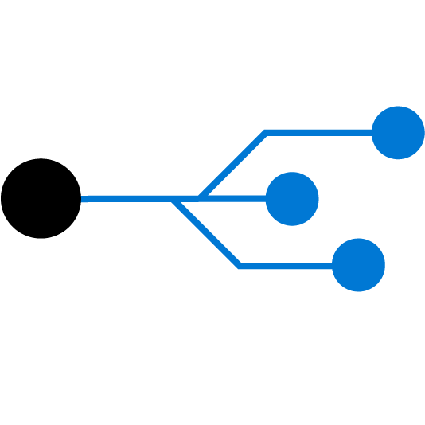
How to do it
Ingest the Data
Explore the Data
Setup a Data Pipeline
Notes:
IoT Hub is a managed service, hosted in the cloud, that acts as a central message hub for bi-directional communication between your IoT application and the devices it manages. You can use Azure IoT Hub to build IoT solutions with reliable and secure communications between millions of IoT devices and a cloud-hosted solution backend. You can connect virtually any device to IoT Hub.
IoT Hub supports communications both from the device to the cloud and from the cloud to the device. IoT Hub supports multiple messaging patterns such as device-to-cloud telemetry, file upload from devices, and request-reply methods to control your devices from the cloud. IoT Hub monitoring helps you maintain the health of your solution by tracking events such as device creation, device failures, and device connections.
IoT Hub's capabilities help you build scalable, full-featured IoT solutions such as managing industrial equipment used in manufacturing, tracking valuable assets in healthcare, and monitoring office building usage.

Slide 14

Data Ingestion
Blob Storage
Data Lake Storage
Databases
Azure Portal
AzCopy
Storage Explorer
Data Factory
Data Import
Data Box
Express Route
Notes:
Storage Services
Blob Storage: Versatile storage for raw data. The most common first place to start storing your data.
Data Lake Storage: Offering a more robust set of access controls than Blob storage and integration with Azure Active Directory which Blob does not offer
Databases: Azure offers SQL Server, MySQL, Postgresql as a service and other database providers with Infrastructure as a Service.
Ways of getting data into Azure
Azure Portal: Manually uploading files via your browser. Only for small files as it’s single threaded and slow
AzCopy: A utility for PowerShell that enables multi-threaded copy activities from on-prem to Azure blob
Storage Explorer: A thick (desktop) client that provides access to
Data Factory: An extraction, transformation, load tool designed for the cloud. Capable of extracting data from on-prem and using multiple Azure services to transform and store the data.
Data Import: Ship hard drives to Azure and have them securely uploaded to the cloud. Maximum size is 40 TB per order. https://docs.microsoft.com/en-us/azure/storage/common/storage-import-export-service
Data Box: Offering up to 100 TB of capacity to be shipped from your data center to the cloud. https://azure.microsoft.com/en-us/services/storage/databox/
Express Route: A direct link into Azure’s data centers to enabled high speed connection without going over the public internet. https://azure.microsoft.com/en-us/services/expressroute/

Slide 15

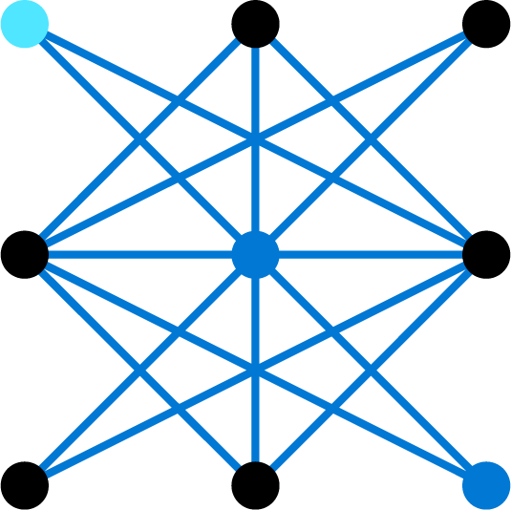


Data Exploration
Incomplete
Data lacks attributes or containing missing values
Noisy
Data contains erroneous records or outliers
Inconsistent
Data contains conflicting records or discrepancies
Relationships
Which variables correlate to each other and the target variable?
Notes:
Exploring the data leads to finding issue and generating data cleansing tasks around it.
Highlight the first three (Incomplete, Noisy, Inconsistent) as data cleansing opportunities with some areas to look at on the right hand-side.
The last one (Relationships) is an opportunity for traditional statistics such as Pearson Correlation or initial models that generate feature importance such as Decision Trees, Random Forests, Lasso Regression.
Inconsistent data records. Check the range of values are allowed. e.g. If the data contains student GPA, check if the GPA is in the designated range, say 0~4.
The number of records.
The number of attributes (or features).
The attribute data types (nominal, ordinal, or continuous).
The number of missing values.
Well-formedness of the data.
If the data is in TSV or CSV, check that the column separators and line separators always correctly separate columns and lines.
If the data is in HTML or XML format, check whether the data is well formed based on their respective standards.
Parsing may also be necessary in order to extract structured information from semi-structured or unstructured data.

Slide 16
Data Cleansing
Missing
Deletion
Discretize
Equal-Width
Equal-Height
Reduce
Sampling Rows
Sampling Columns
Frequent substitution:
Regression substitution
Dummy substitution
Mean substitution
Normalize
Min-Max
Z-Score
Decimal Scaling
Aggregation
Notes:
https://docs.microsoft.com/en-us/azure/machine-learning/team-data-science-process/prepare-data
Min-Max Normalization: Linearly transform the data to a range, say between 0 and 1, where the min value is scaled to 0 and max value to 1.
Z-score Normalization: Scale data based on mean and standard deviation: divide the difference between the data and the mean by the standard deviation.
Decimal scaling: Scale the data by moving the decimal point of the attribute value.
Equal-Width Binning: Divide the range of all possible values of an attribute into N groups of the same size, and assign the values that fall in a bin with the bin number.
Equal-Height Binning: Divide the range of all possible values of an attribute into N groups, each containing the same number of instances, then assign the values that fall in a bin with the bin number.

Slide 17








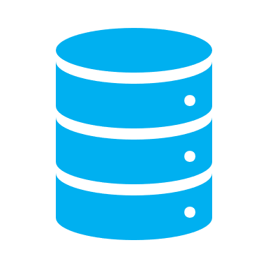


Set Up a Data Pipeline
Realtime
Batch Processing
C#
Copy from on-prem to same structure in Azure, score data
Receive a request from web app, pull data from database, transform data, return to web app
Copy, transform and cleanse data, store, score data
Notes:
Designing a solution architecture requires thinking through the way your users will consume the model results.
For batch processing, using a tool like Data Factory to regularly schedule data refreshes and coupling it with a compute engine, such as database stored procedures or Spark / Databricks transformation code can be an effective solution.
For realtime processing that require responses measured in milliseconds, turning to Azure Functions to orchestrate calls to databases and machine learning models is an effective route. In addition, you could add Python or C# code to do data transformations inside the function itself.

Slide 18

Artifacts of Data Acquisition and Understanding
Data Quality Report
Solution Architecture
Checkpoint Decisions
Notes:
The next steps are to begin analyzing your data and produce a processed data set that is free of missing values and biases.
In order to reach that point, the data scientists need to build a repeatable pipeline to ingest the data using some form of scripting or application.
The data scientist explore the data to find any issue with the data and details how they changed the data and document any assumptions being made (e.g. replacing missing values by the stratified mean is okay because…)
The outcomes include:
Data Quality Report that provides an overview of issues with the data and provides a reference to what variables are important with respect to the target variable.
https://docs.microsoft.com/en-us/azure/machine-learning/team-data-science-process/lifecycle-data

Slide 19
Modeling

Slide 20


How to Do It
Feature Engineering
and Feature Selection
Create, Train, and
Evaluate Models
Notes:
In the modeling phase, Data Scientists leverage the work done in previous steps to build features off of their processed data set and train models off of the set of features identified as relevant.
Feature Engineering is the process of
Generating new variables (e.g. converting categorical variables into dummy variables)
Transforming variables (e.g. rescaling the variable)
Feature Selection is choosing which variables to keep
After generating the feature set, models are trained either by hand or using automated packages. During this process, the data scientist ensures that the model is valid by performing cross-validation and training with different subsets of the data and evaluating on a separate set of data.
After a champion model is selected, the data scientist prepares for production by questioning their methods and thinking critically of the data and goal they are trying to achieve.

Slide 21

Feature Engineering & Selection
Aggregate Counts and Bins
Temporal Counts
Scaling/Normalization
Dummy/One-Hot Encoding
Interaction Terms
Cluster Labels
Principal Components
Model Stacking
Stepwise elimination
Removing Multi-collinearity
Feature Importance/Interpretation
Avoid Data Leakage
Notes:
Emphasize the art of feature engineering and the wide variety of techniques that are dependent on the task and data at hand.
Another reference you can point your customer to is the Feature Engineering Book at O’Reilly:
https://learning.oreilly.com/library/view/feature-engineering-for/9781491953235/
The three Feature Selection techniques on the right consist of :
Stepwise Elimination: Linear Regression models use this technique and iteratively add or remove variables
Multi-collinearity is when two or more variables are highly correlated with each other. This can confuse variable importance and interpretation because in a linear model the two variables might randomly share some of their coefficients or one variable might be turned negative and cancel out the other variable.
Feature Importance can be learned through statistical tests or through model interpretation. For example, variables closer to the root of a decision tree separate the class variables more than those further down the tree. Random Forest can generate a set of feature importance by observing all of the trees in the model and aggregating how often and where a given variable is used in the trees.
Data Leakage is where a variable is a powerful predicter but it accidentally gives away some information. For example, a Customer ID is used as a feature but the Customer’s who are older have survived several data purges and are considered to be more valuable by your model. The model would indicate a negative relationship between Customer ID and Sales. Another example would be a situation where the data scientists doesn’t realize that the “Quantity Shipped” variable is populated at the end of the day and thus “leaks” information that you wouldn’t have available at modeling time.

Slide 22
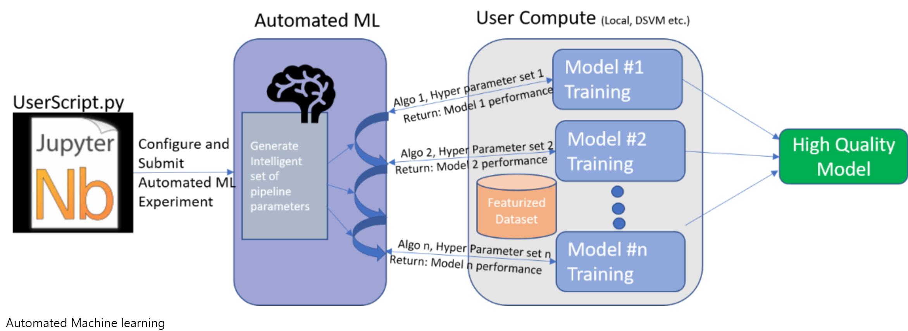
Train Models
Start with Automated Model Selection
Use Hyperparameter Tuning
Iterate and select best from model runs
Learn from automation and finely tune
Cross Validation & Train, Test, Validation Data
Notes:
https://docs.microsoft.com/en-us/azure/machine-learning/service/concept-automated-ml
Great Data Scientists leverage automated tools to identify high potential algorithms, hyperparameters, and features faster than intuition and manually trying different combinations. With cloud computing and multi-threaded processing there is little stopping data scientists from generating candidate models sooner. These candidate models can then be examined and learned from as the Data Scientist finely tunes their final models.
Automated Model Selection using Azure Automated ML can significantly increase the time to production. Given a well crafted training data set, Data Scientists can leverage these automated techniques to guide their fine-tuning of model creation. At the very least, Data Scientists can use automated ml models to identify algorithms that fit the data but do not overfit.
Hyperparameter tuning is the process of training using the same algorithm but pulling different levers and turning different dials. For example, a hyperparameter for a Decision Tree is how large the decision tree may grow until it is (artificially) stunted.
The process is iterative and models generated should spawn new feature ideas or identify different algorithms that should be included in the candidate model space. Automated model generation may not create models that fit the intuition of the data scientist and should be reviewed to make sure they are sound against the domain (e.g. you may expect a positive sign on a coefficient of a linear model but the “best” model selected by an automation tool has a negative sign).
Cross Validation & Train, Test, Validation Data: To ensure that you avoid overfitting your data you make sure you use techniques like cross-validation to ensure that your model generalizes to unseen data. Using a validation set, you remove a set of data and never expose your model to it until you’re sure this is your final model.
Using a tool like Azure Machine Learning Services enables the data scientist to try many different techniques and to always be able to pull back the model from each training run. This enables the data scientist to move fast and not have to manage multiple model states by themselves.

Slide 23
Prep for Production
Does the model answer the question with enough confidence given the test data?
Should you try any alternative approaches?
Would a simpler model perform similarly?
Can the data be accessed and processed in the required amount of time?
Batch jobs depending on input data availability
Real-time jobs depending on data transformations
Should you collect additional data, do more feature engineering, or experiment with other algorithms?
Is the model resilient to edge cases?
Notes:
These are questions that the data scientist should be asking themselves prior to handing off any models to engineers for deployment.
This ensures that the project team are considering multiple avenues and maintaining simplicity over complexity.

Slide 24

Artifacts of Modeling
Feature Set
Model Report
Checkpoint Decisions

Slide 25
Deployment

Slide 26

Operationalize the Model
Deployment
Where will the model exist?
How will you handle edge cases?
Managing Models
Recording model telemetry
Retraining frequency
Versioning models
Notes:
With a model selected, deployment requires considering what technology will be used to deploy the model and how you will manage the model once it has been deployed.
As part of Data Science Core enablement, we offer a session on DevOps for Data Science which can go into further depth on model management.
The outcome of this deployment would include:
Telemetry dashboard: to enable monitoring of the model performance both in terms of web service and prediction accuracy if a feedback loop is possible.
A final model
A final architecture and documentation for future reference

Slide 27



Where the Models Exist
SQL Server – On-Prem
Python, R, Spark (2019)
Web API
Kubernetes Cluster
Spark Cluster
Batch Scripts
Notes:
You can commonly deploy to the following scenarios:
Database: Azure SQL and other providers have integrations with R or Python
Deploy as a Web API: Creating a RESTful endpoint. This can be accomplished with an Azure Web App
Kubernetes Cluster: This is an even more scalable version of a Web API
Spark Cluster: Requires running a spark or databricks cluster to do the scoring.
Batch: Azure Batch is capable of running scoring scripts on multiple datasets in parallel and is useful for where the data can be brought to scripts.

Slide 28

Target | Use Cases | Microsoft / Azure Service
In-Database | Data is already in DB, why move it? Batch processing of data with ML model Leverage Python or R | SQL Server 2017+
Kubernetes Cluster / API | Real-time scoring Need autoscaling for variable traffic demand Leverage Python | Azure Kubernetes Service Azure Container Instances Roll Your Own VM
R and Python Server | Batch or API scoring Legacy tool Leverage R and Python | Azure HDInsight ML Server
Spark Cluster | Batch or near-real time processing Leverage parallel algorithms with ease Leverage Python, Spark, or Java | Azure HDInsight Azure Databricks Aztk
Batch Job | Batch workloads where data can be scored in parallel Leverage any language | Azure Batch Azure ML Compute
Notes:
Review the use cases and identify where the customer wants to deploy their own workloads in the short-term and the long-term (e.g. just use batch jobs now but want to get to Spark)
Address the limitations of the services to provide a balanced argument:
In-database Python/R scripts make unit testing more difficult
Kubernetes cluster deployment means you need to manage that cluster
Deploying to spark means you need to have that cluster up and running and can be expensive if doing streaming
Batch jobs are simple to leverage but require you to be able to split the data when they are written to blob for easy download to individual VMs for each segment.

Slide 29




Model Management
Model Telemetry
Number of requests
Number of failures
Latency
Record input and output
Model Versioning
Storing Binaries
Model Retraining
Data Pipeline
Model drift detection
Challenger models
Edge Cases
Nulls
New categorical data
Numeric out of range
Does not conform to business rules

Slide 30
Artifacts of Deployment
Final model
Final Architecture and Documentation
Telemetry dashboard

Slide 31
Customer Acceptance

Slide 32


How to Do It
Validation
Confirm deployed model
meets customer needs
Hand-Off
Finalize Documentation
Generate Operation Guide
Notes:
Once an internal or external “customer” has received the model, it must be vetted that the goals have been met.
Having created SMART goals earlier on leads to a sort of contract between project team and customer that everyone has agreed on, making this stage much easier.
In this last stage, the project team also needs to finalize their documentation and provide an operations guide to aide the customer with managing their new model.
At the end of this stage, an exit report is produced that provides a summary of the full lifecycle and learnings that occurred during the project.
https://github.com/Azure/Azure-TDSP-ProjectTemplate/blob/master/Docs/Project/Exit%20Report.md

Slide 33


Validation
Predictions perform within expected bounds
Deployment can be integrated with end user application
Notes:
The customer providing this validation may be an internal customer or an external customer.
As discussed prior, a SMART goal should have been defined that is unambiguous and provides a clear cut definition of what success looks like.
As part of the deployment process, the customer’s ability to execute the model should have been considered and ultimately integrated into whatever tooling they are using – e.g. embedding the real-time API into an Excel Add-in or creating a triggering system for scheduled batch jobs.

Slide 34


Hand Off
Documentation
Final model architecture diagram
Data Pipeline diagram
Steps to pre-process
Validation techniques
All code / functions documented
Purpose and Benefits of model
Operation Guide
Metrics dashboard
Required fields
How edge cases are handled
Authentication
Security
Notes:
As part of the Exit Report, the project team has fully documented the project and created an operations guide that clearly shows how to run the model and maintain it.
While it’s not the coolest thing to do, properly documenting the project will make it much easier to maintain the model and its supporting software for the long run.
An operation guide provides all the instructions for how to use and manage the model and supporting software. The challenge for data science projects is that the software engineer often treats the algorithm / API as a opaque box and doesn’t understand what is happening underneath. As a result, the project team should emphasize the limitations of the model and if / how data is being collected for retraining purposes. This gives the dev team a more transparent box rather than a black box algorithm to work with.

Slide 35

Artifacts of Customer Acceptance
Exit report of the project
for the customer

Slide 36
Thank You

